Slide 1

Mobile apps for healthcare
Edie Watson, BSN, RN

Slide 2
Mobile apps for healthcare
There are provider focused apps and patient focused apps
It is becoming more and more necessary to incorporate technology into our care
Many apps have not been studied and do not have evidence that they are of benefit, but providers can still use their own judgment when deciding which apps to share with patients
Patient focused healthcare apps should:
  Be easy to use and straight-forward for patients of all education levels
  Have a way of maintaining patient privacy and security of information
  Reflect accurate health information

Slide 3
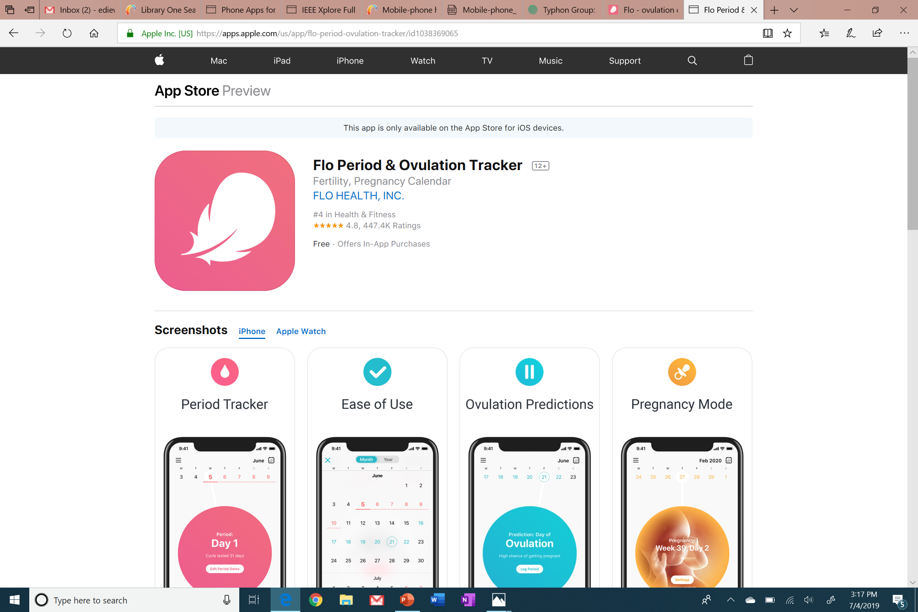
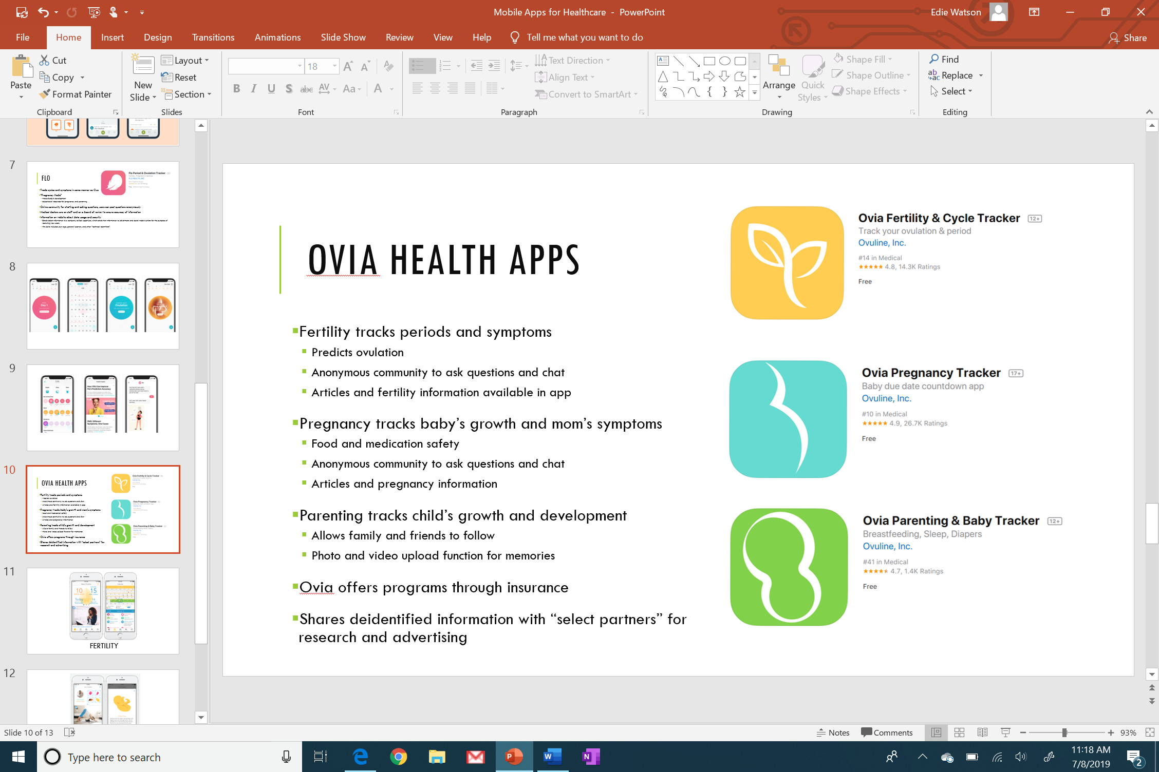
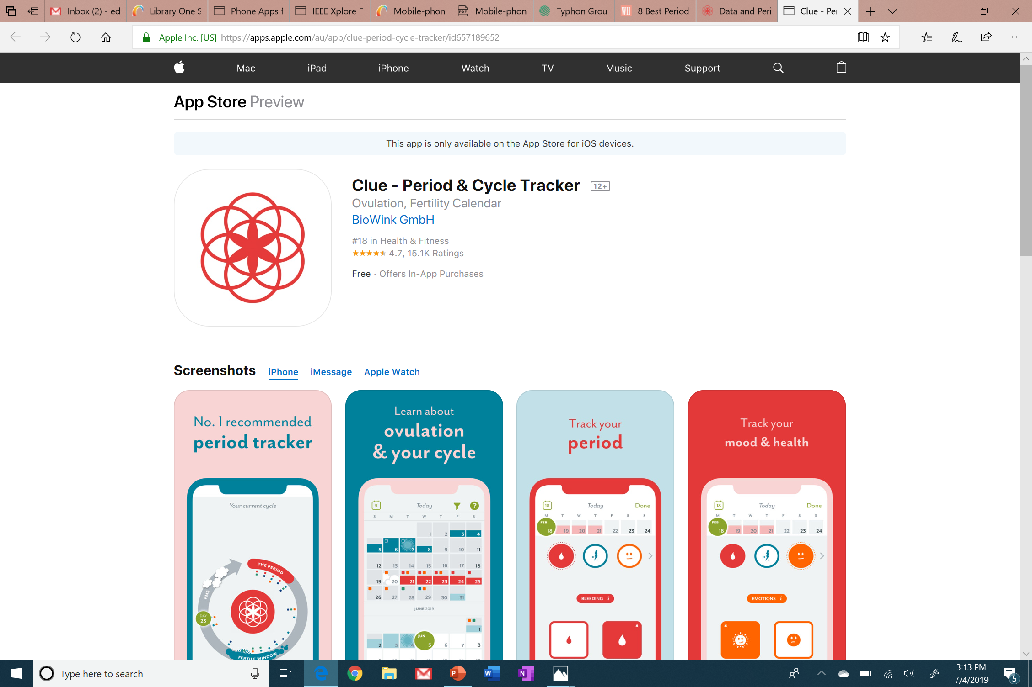
Women’s health apps
There are many different apps for tracking periods, ovulation, pregnancy, and parenting milestones
Many apps are marketed as helping women prevent or achieve pregnancy, depending on their goals
(Biowink, 2019; Flo Health, 2019; Ovuline, 2018a; Ovuline, 2018b; Ovuline, 2018c)

Slide 4
Clue
Tracks cycles and symptoms
  Headaches
  Cramps
  Acne
  Mood changes
Tracking options include sexual activity, work, stress, alcohol, diet, and many more
References included for educational content, website has plenty of educational resources
Information on website about data usage and security
  Shares deidentified data with selected researchers but does not sell data to advertisers or data brokers
(Biowink, 2019)

Slide 5
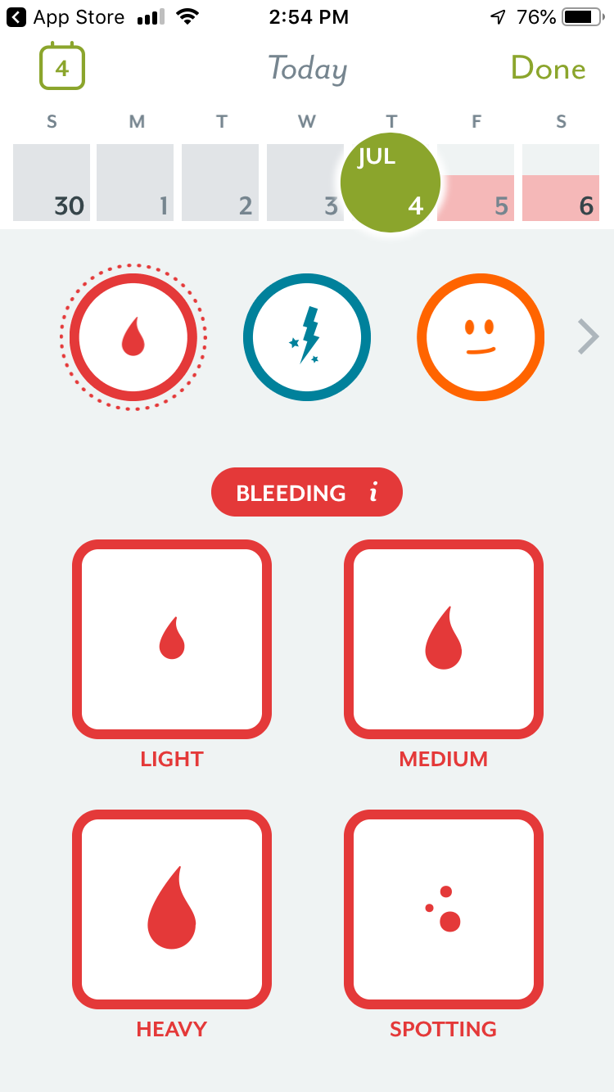
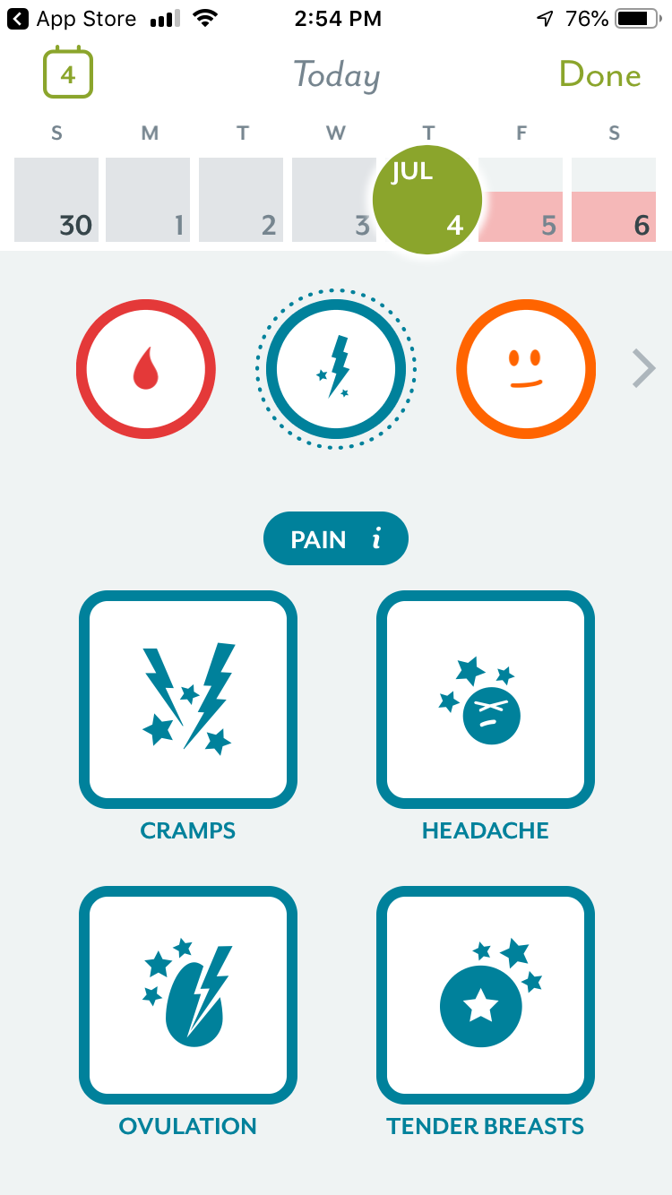
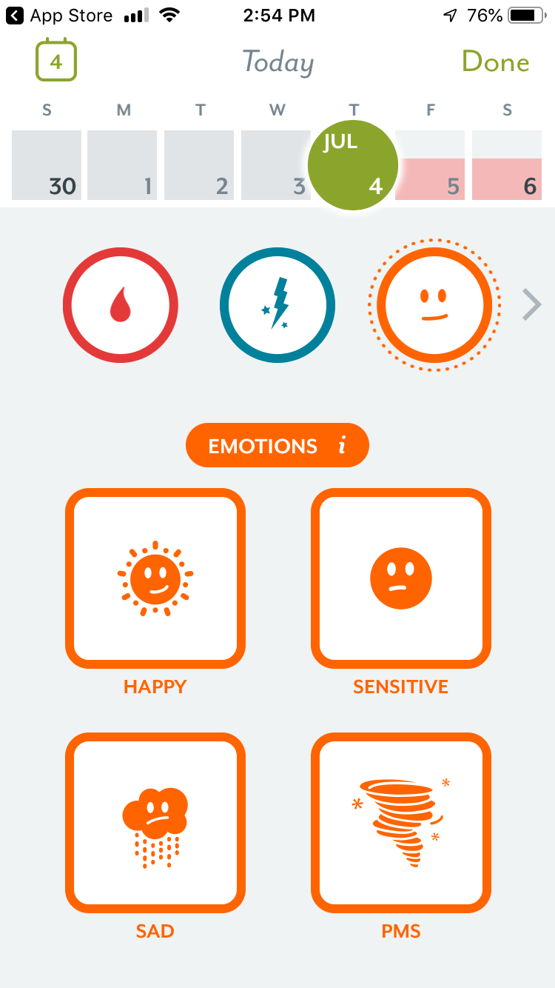
(Biowink, 2019)

Slide 6
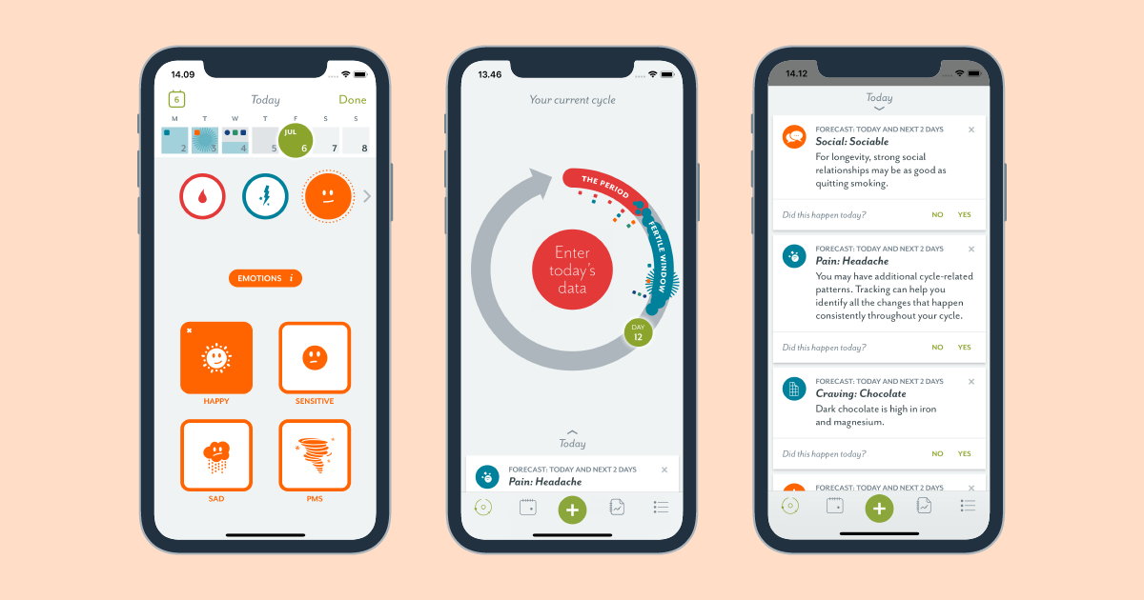
(Biowink, 2019)

Slide 7
FLO
Tracks cycles and symptoms in same manner as Clue
“Pregnancy Mode”
  Tracks baby’s development
  Educational resources for pregnancy and parenting
Online community for chatting and asking questions, users can post questions anonymously
Medical doctors are on staff and on a board of review to ensure accuracy of information
Information on website about data usage and security
  Sends select information to a company called AppsFlyer, which sends that information to advertisers and social media outlets for the purpose of recruiting new users
  This data includes your age, general location, and other “technical identifiers”
(Flo Health, 2019)

Slide 8
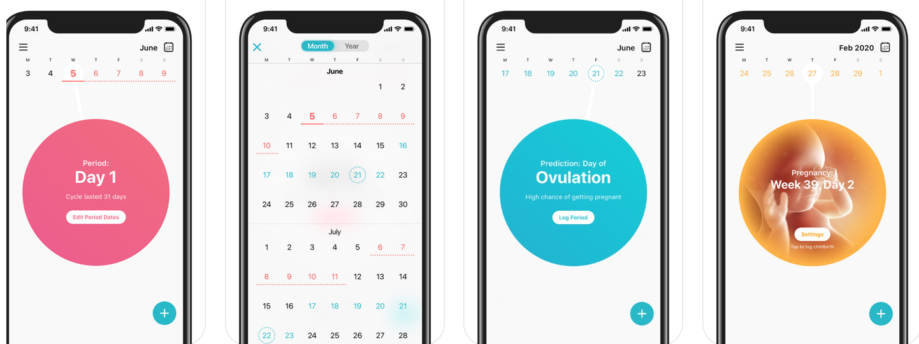
(Flo Health, 2019)

Slide 9
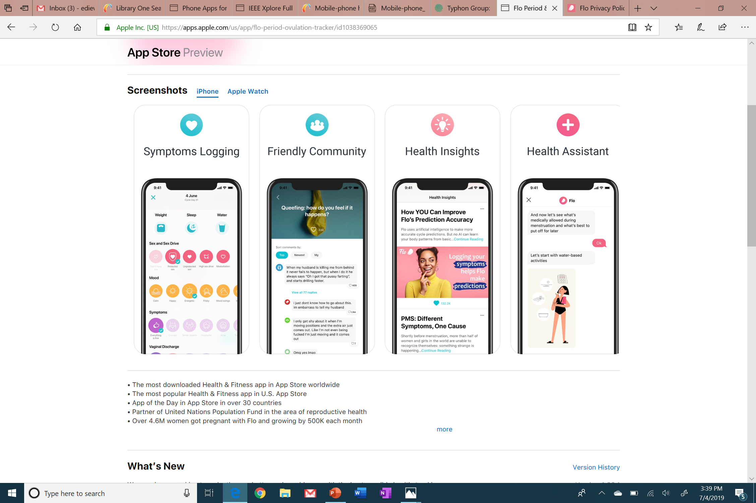
(Flo Health, 2019)

Slide 10
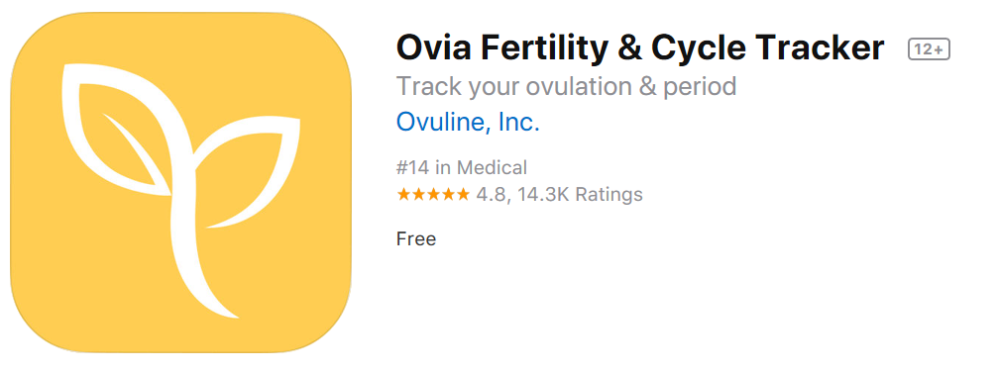
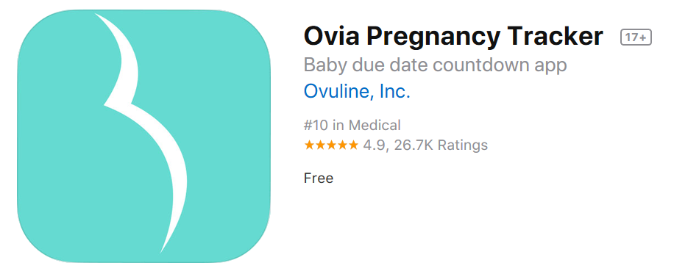
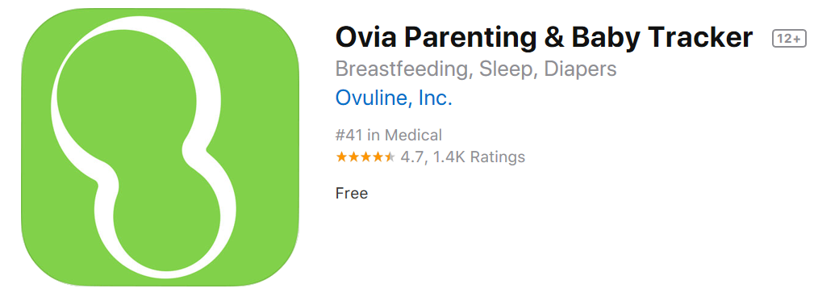
OVIa Health apps
Fertility tracks periods and symptoms
  Predicts ovulation
  Anonymous community to ask questions and chat
  Articles and fertility information available in app
Pregnancy tracks baby’s growth and mom’s symptoms
  Food and medication safety
  Anonymous community to ask questions and chat
  Articles and pregnancy information
Parenting tracks child’s growth and development
  Allows family and friends to follow
  Photo and video upload function for memories
Ovia offers programs through insurance
Shares deidentified information with “select partners” for research and advertising
(Ovuline, 2018a; Ovuline, 2018b; Ovuline, 2018c)

Slide 11
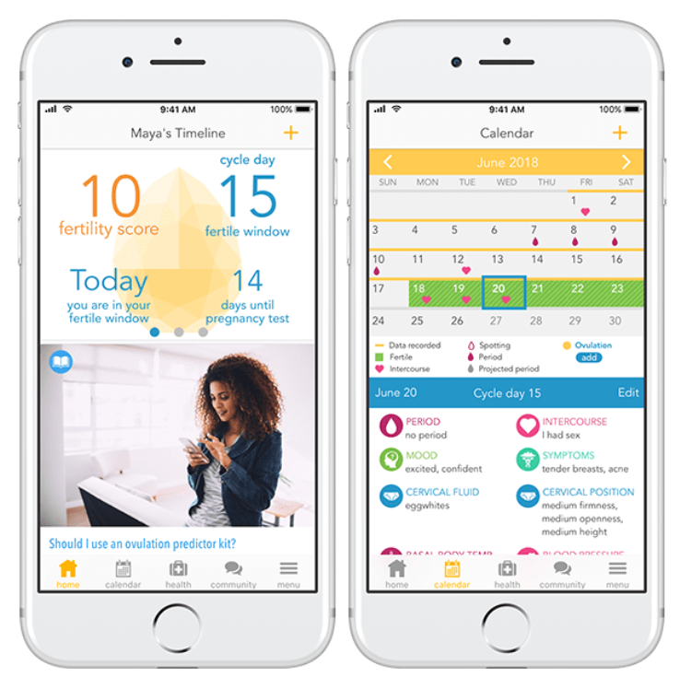
FERTILITY
(Ovuline, 2018a)

Slide 12
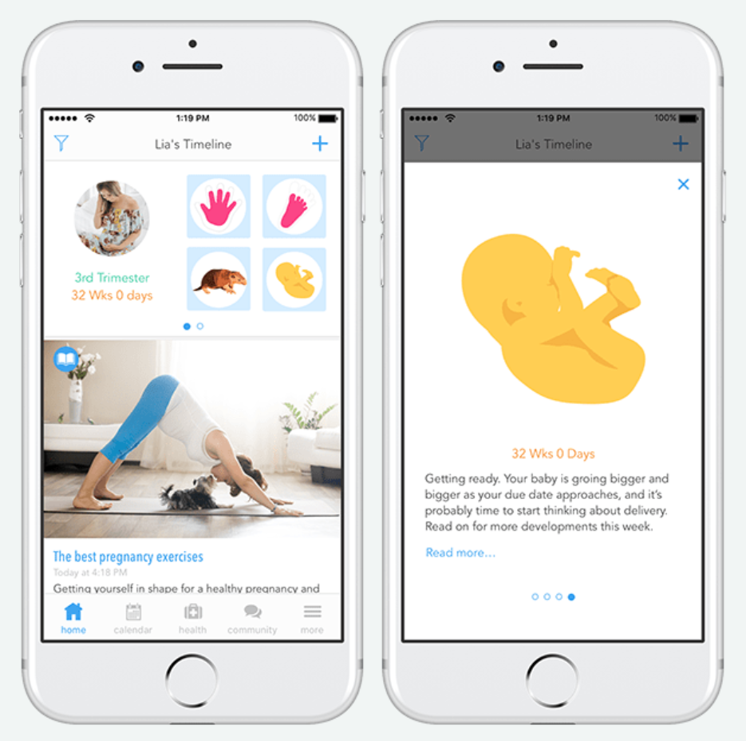
PREGNANCY
(Ovuline, 2018b)

Slide 13
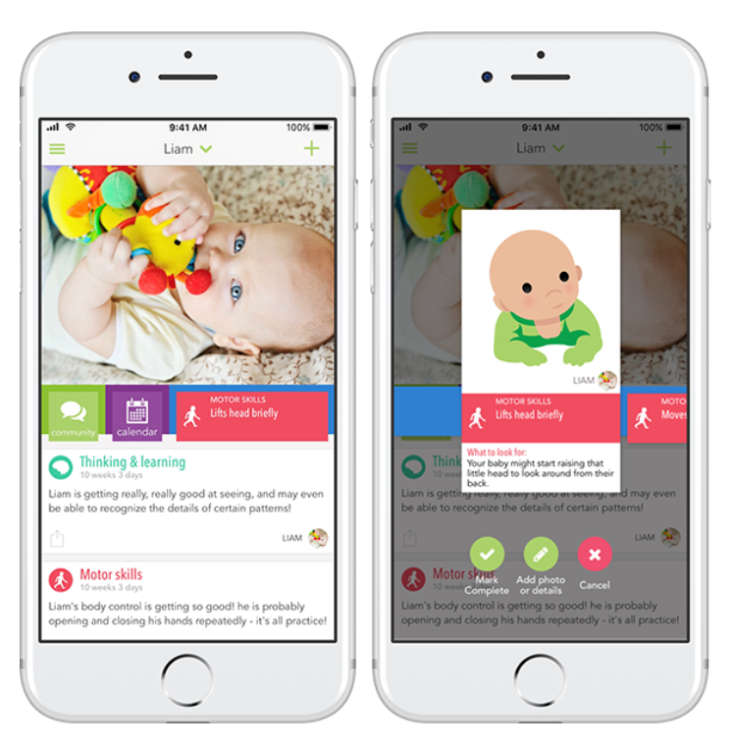
PARENTING
(Ovuline, 2018c)

Slide 14
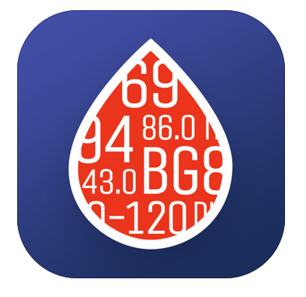
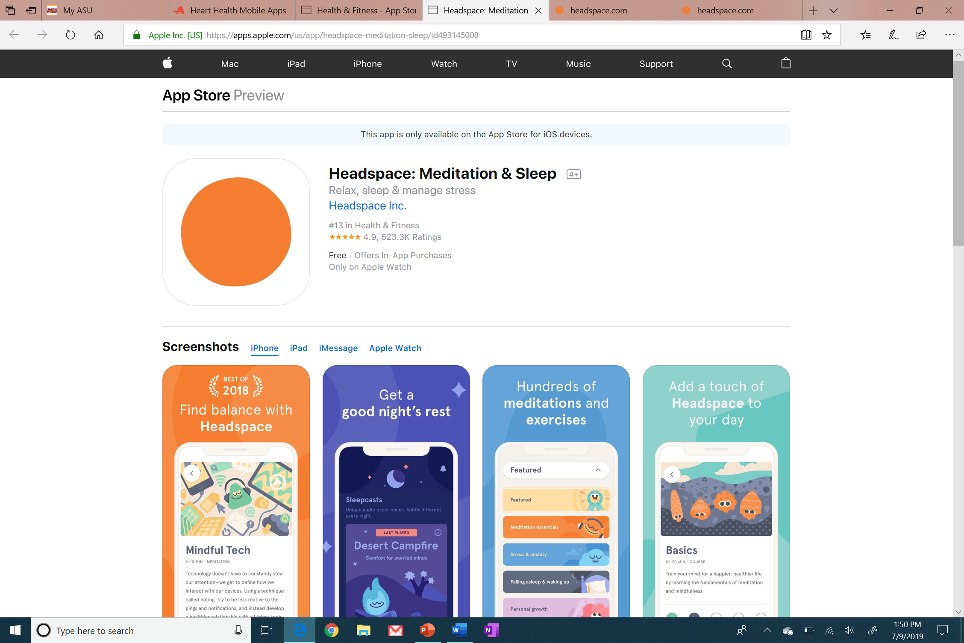
Primary care apps
There are many apps available that help patients keep track of blood sugars, blood pressures, diet, and exercise
Some apps link to the provider’s chart, or have functions that allow patients to communicate with their provider through the app
(Azumio, 2017; Headspace, 2019)

Slide 15

Glucose buddy
Tracks blood glucose values, insulin dosages, exercise, and carb intake
Allows patients to see trends in their blood glucose values and correlate them with dietary modifications
Basic app is free but allows subscription to premium app for $40 per year
  A1C calculator, customized entry tags for easier logging, and no ads
Easy way to have patients show you their glucose logs and provides an opportunity for discussion with their provider
Acknowledges that it may share your deidentified data with its affiliates and may even share personal data under certain circumstances
(Azumio, 2017)

Slide 16
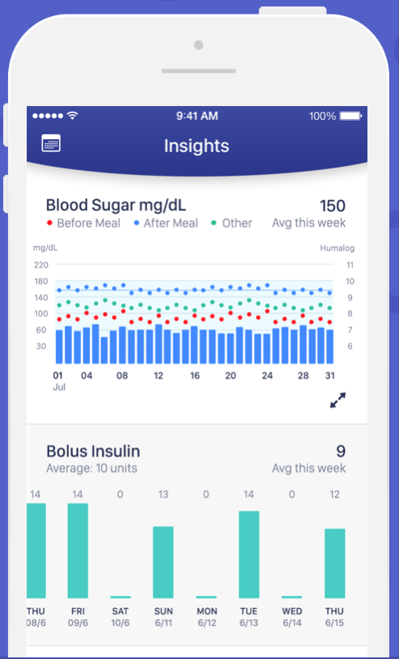
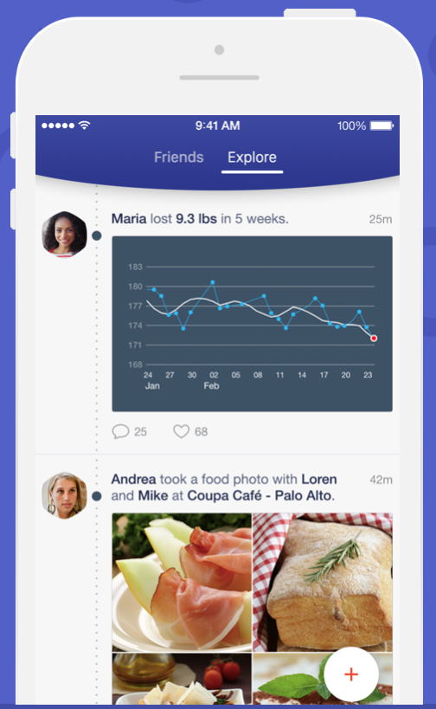
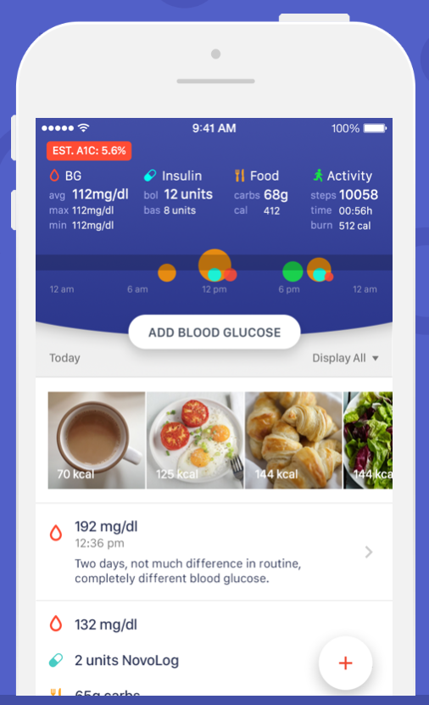
(Azumio, 2017)

Slide 17
headspace
Provides guided meditation for the purposes of stress reduction, sleep improvement, improved focus, reduced anxiety, and more
  The app has been studied in various populations from cancer patients to employees in a workplace
  Many references are provided on the website
Free basic meditation course upon signing up, subscription is $13 per month or $95 per year
Variety of meditation session lengths and purposes, and a separate tab for sleep mode with relaxing sounds and specialized meditation sessions
Acknowledges on their website they may share the information you provide to them with any of their affiliates or subsidiaries for various purposes, including advertising
(Headspace, 2019)

Slide 18
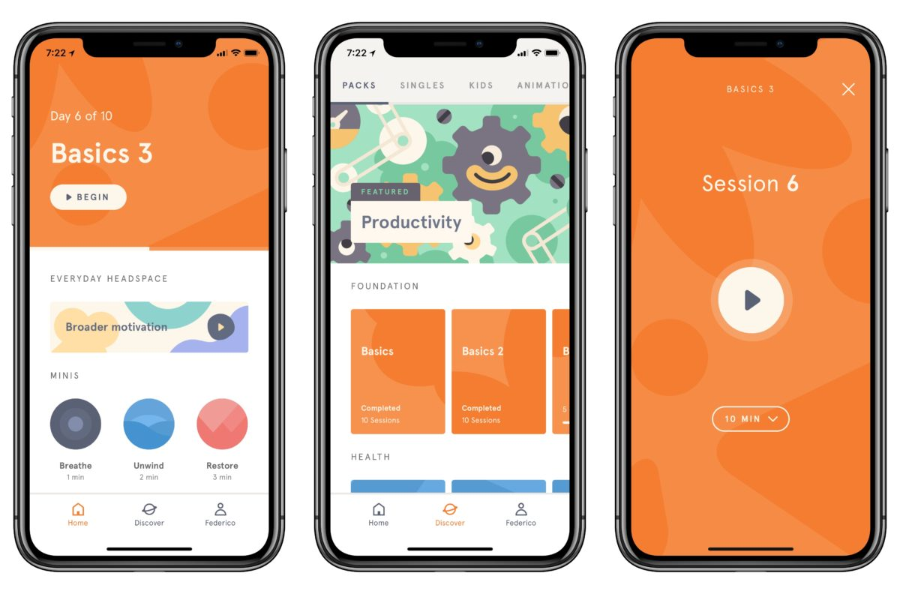
(Headspace, 2019)

Slide 19
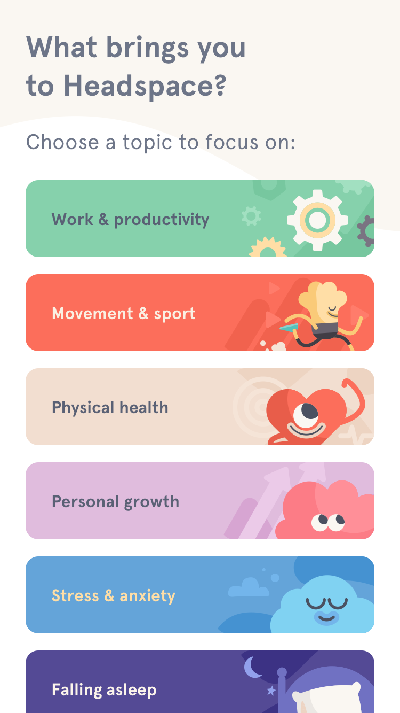
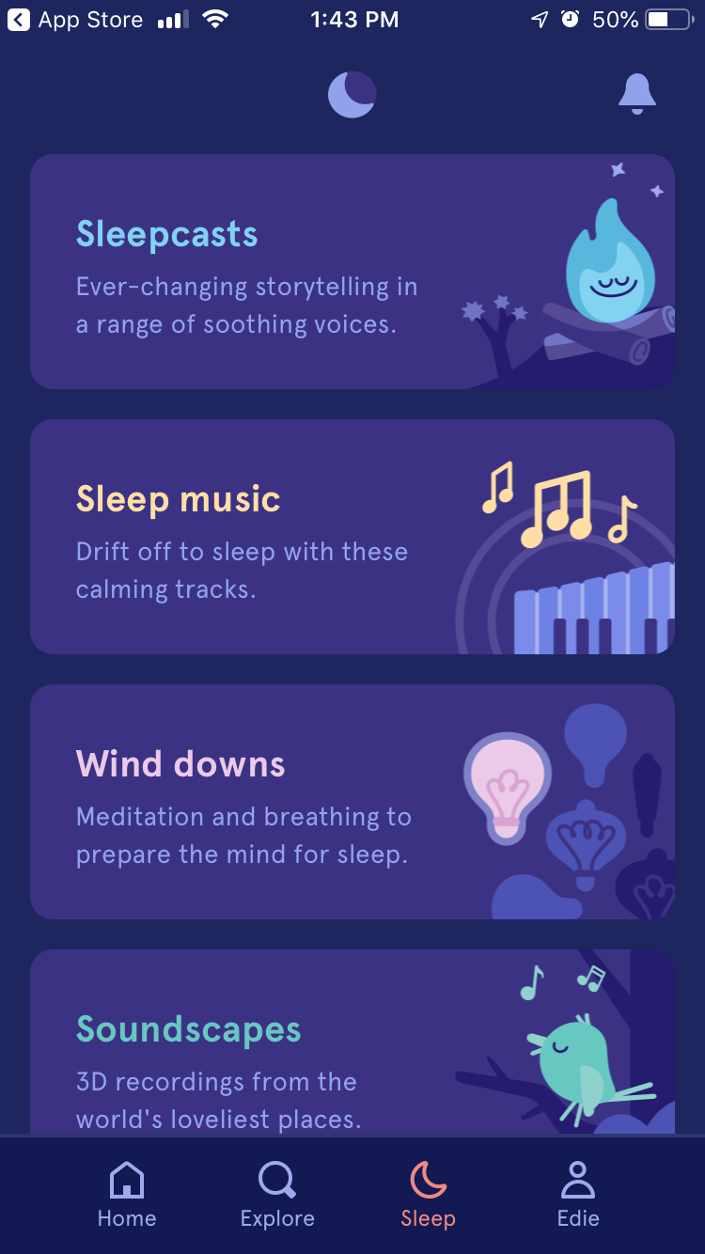
(Headspace, 2019)

Slide 20
references
Azumio, Inc. (2017). Glucose Buddy (5.188) [Mobile application software]. Retrieved from https://apps.apple.com/us/app/glucose-buddy-diabetes-tracker/id294754639
Biowink. (2019). Clue Period and Cycle Tracker (5.18) [Mobile application software]. Retrieved from https://apps.apple.com/us/app/clue-health-period-tracker/id657189652
Flo Health, Inc. (2019). Flo Period and Ovulation Tracker (4.36.1) [Mobile application software]. Retrieved from https://apps.apple.com/us/app/flo-period-ovulation-tracker/id1038369065
Headspace, Inc. (2019). Headspace: Meditation and Sleep (3.67.0) [Mobile application software]. Retrieved from https://apps.apple.com/us/app/headspace-meditation-sleep/id493145008

Slide 21
references
Ovuline, Inc. (2018a). Ovia Fertility and Cycle Tracker (4.3.4) [Mobile application software]. Retrieved from https://apps.apple.com/us/app/ovia-fertility-cycle-tracker/id570244389
Ovuline, Inc. (2018b). Ovia Pregnancy Tracker (4.2.5) [Mobile application software]. Retrieved from https://apps.apple.com/us/app/ovia-pregnancy-tracker/id719135369
Ovuline, Inc. (2018c). Ovia Parenting and Baby Tracker (1.5.2) [Mobile application software]. Retrieved from https://apps.apple.com/us/app/ovia-parenting-baby-tracker/id1106614359

